Slide 1

High Impact Skills Development Program
in Artificial Intelligence, Data Science, and Blockchain
Module 1: AI Fundamentals
Lecture 2: Linear Regression
Instructor: Dr Latif Anjum
NUST – SEECS

Slide 2
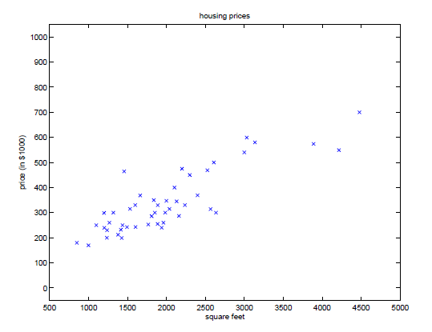
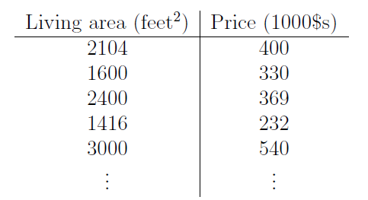




Linear Regression
$$x^{(i)}$$
Input
$$y^{(i)}$$
Output
$$(x^{(i)},y^{(i)})$$
A training example
$$\left\{\left(x^{(i)},y^{(i)}\right);i=1,2,3,…,m\right\}$$
A training set

Slide 3
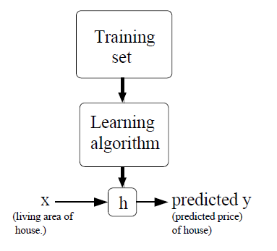

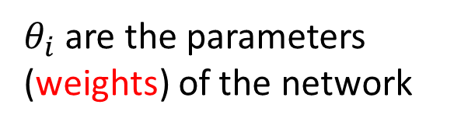
Linear Regression
$θ_{i}$are the parameters (weights) of the network

Slide 4
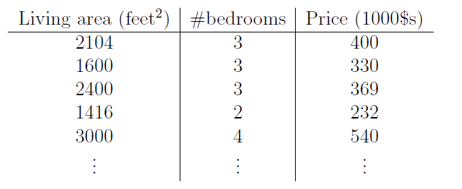
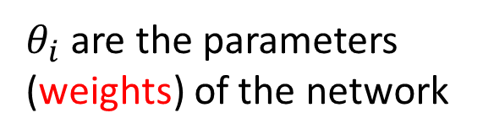
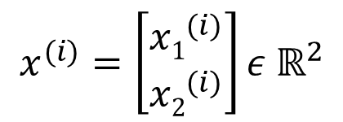
Linear Regression
$$x^{(i)}=\left[\begin{matrix}{x1}_{}^{(i)} \\ {x2}_{}^{(i)}\end{matrix}\right]ε{ ℝ}^{2}$$
$θ_{i}$are the parameters (weights) of the network

Slide 5
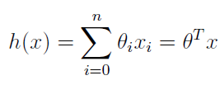
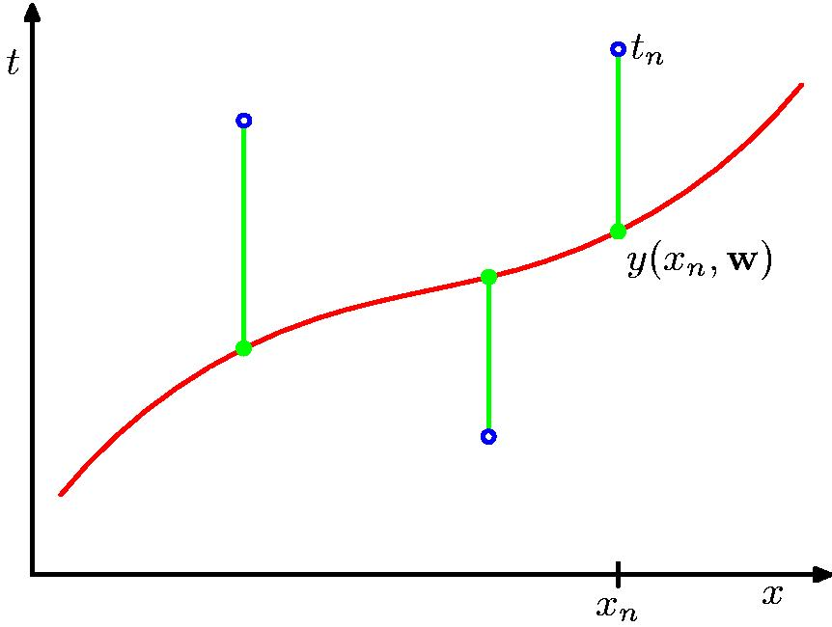
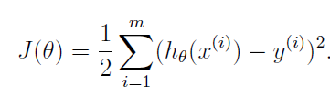
Linear Regression
Cost Function

Slide 6
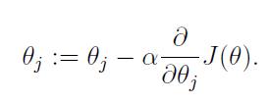
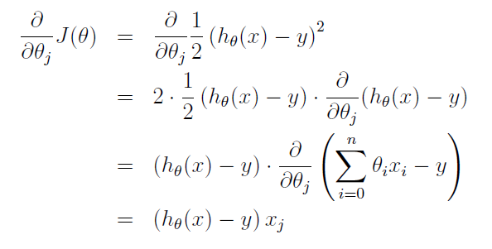

Linear Regression
Minimizing the Cost Function: Gradient Descent
For one training example

Slide 7
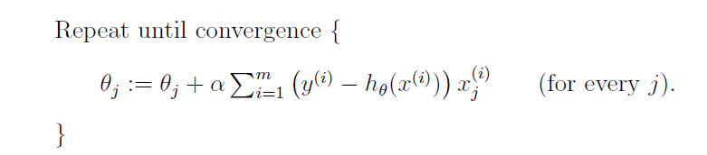
Linear Regression
Minimizing the Cost Function: Gradient Descent
For complete training set

Slide 8


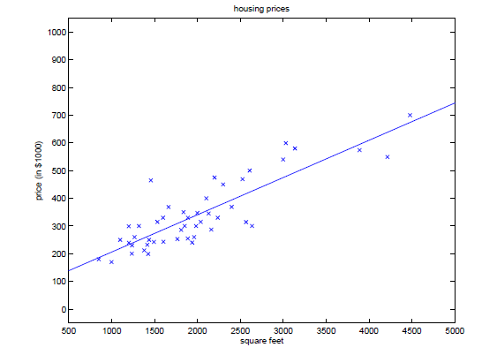
Linear Regression

Slide 9
Linear Regression
Regression
Classification

Slide 10
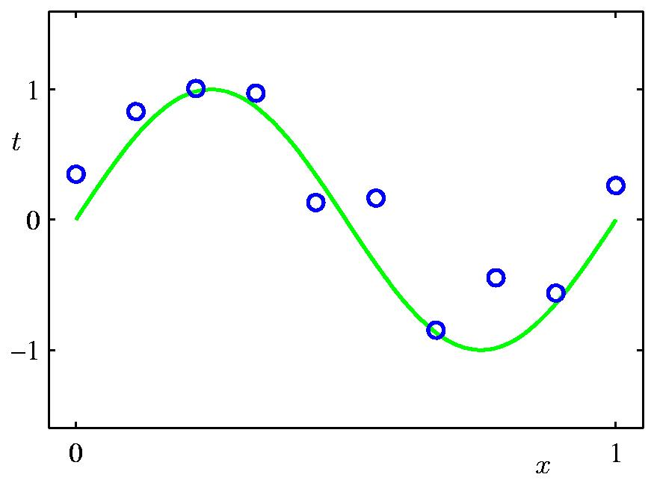
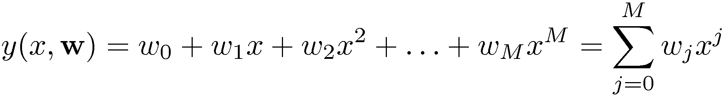
Polynomial Curve Fitting

Slide 11
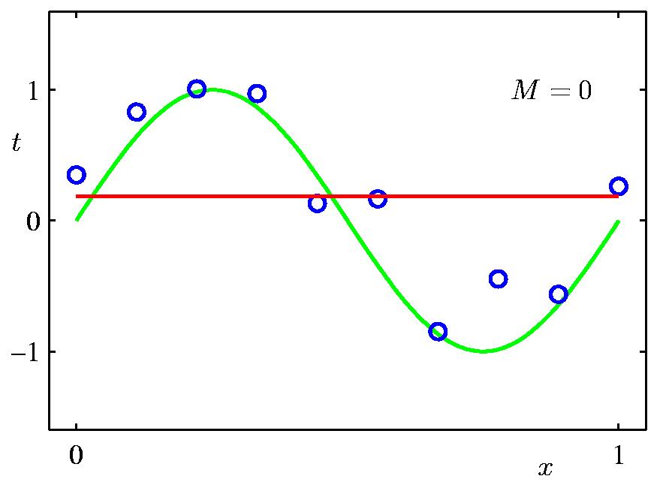
0th Order Polynomial

Slide 12
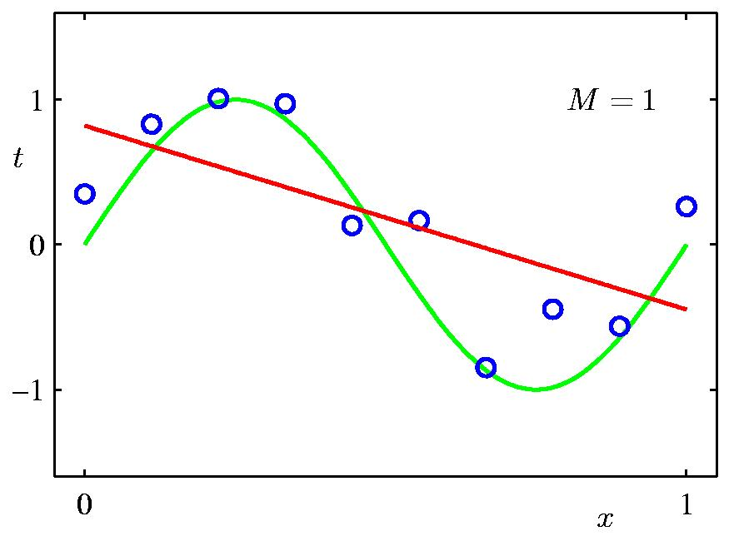
1st Order Polynomial

Slide 13
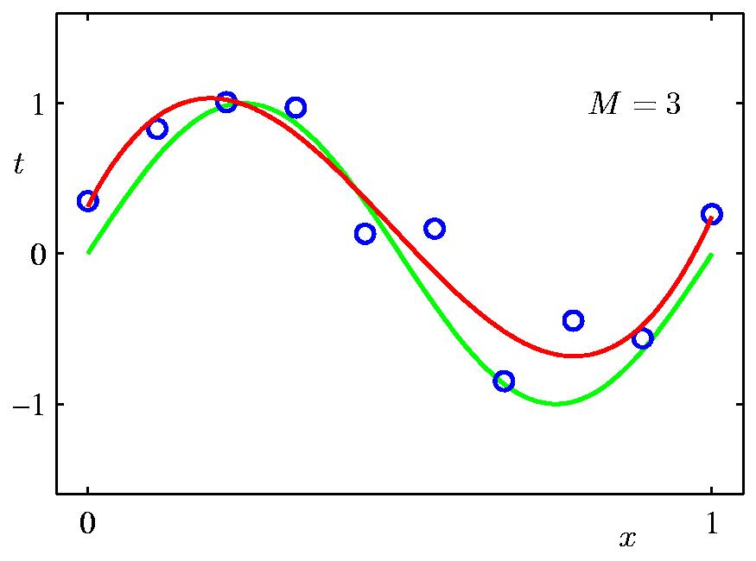
3rd Order Polynomial

Slide 14
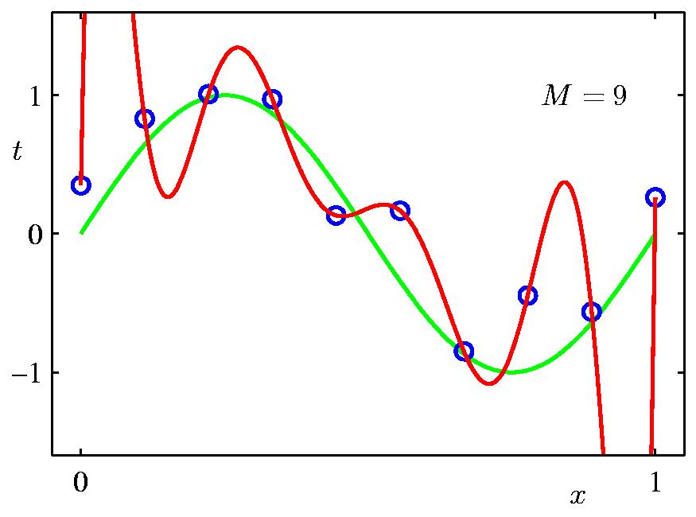
9th Order Polynomial

Slide 15

Typical Challenges in
Machine Learning

Slide 16
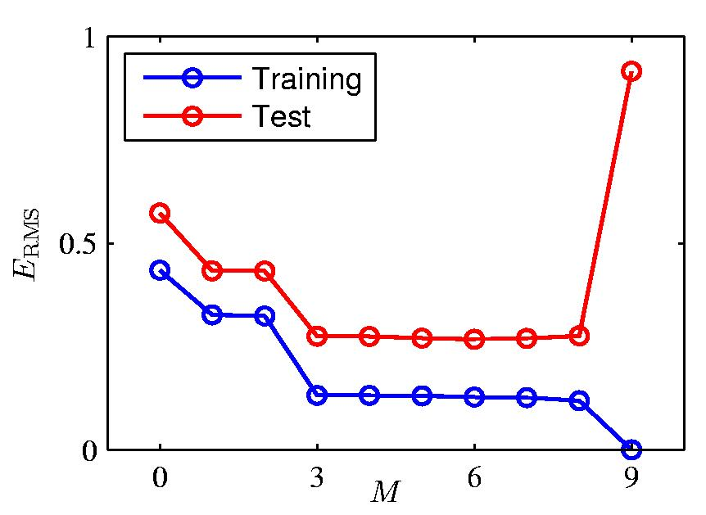
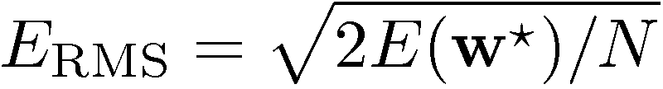
Over-fitting
Root-Mean-Square (RMS) Error:

Slide 17
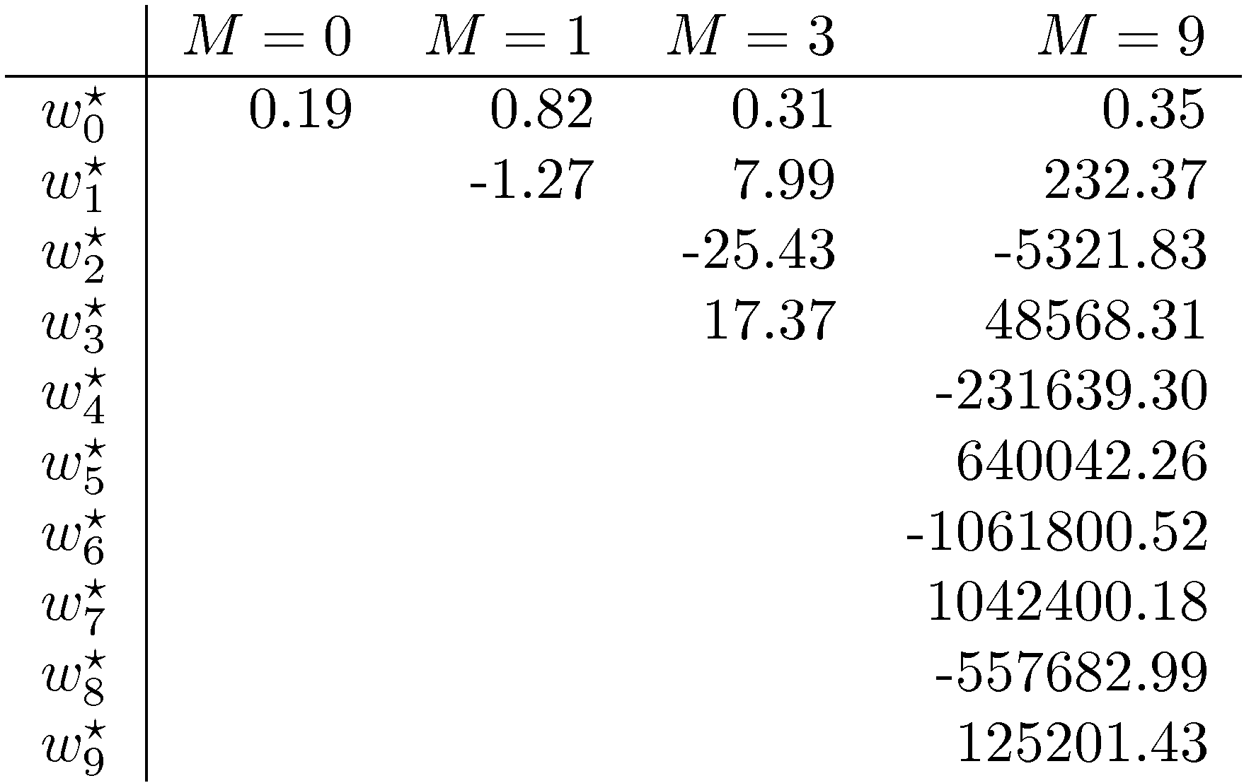
Polynomial Coefficients

Slide 18
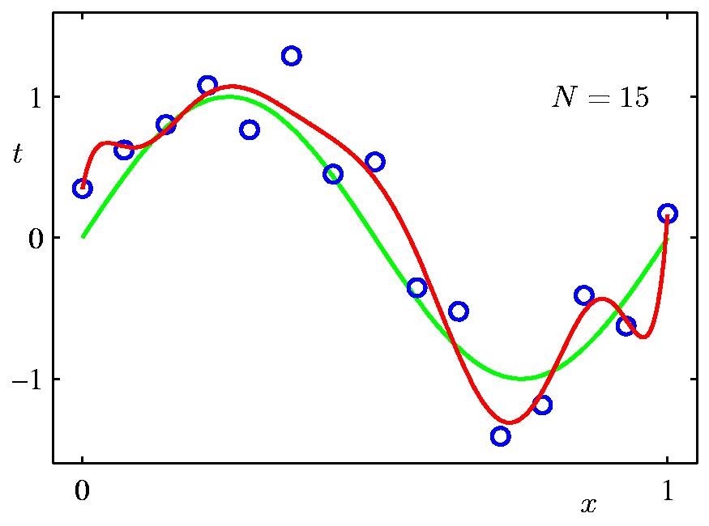
Dataset Size:
9th Order Polynomial fitted on 15 samples

Slide 19
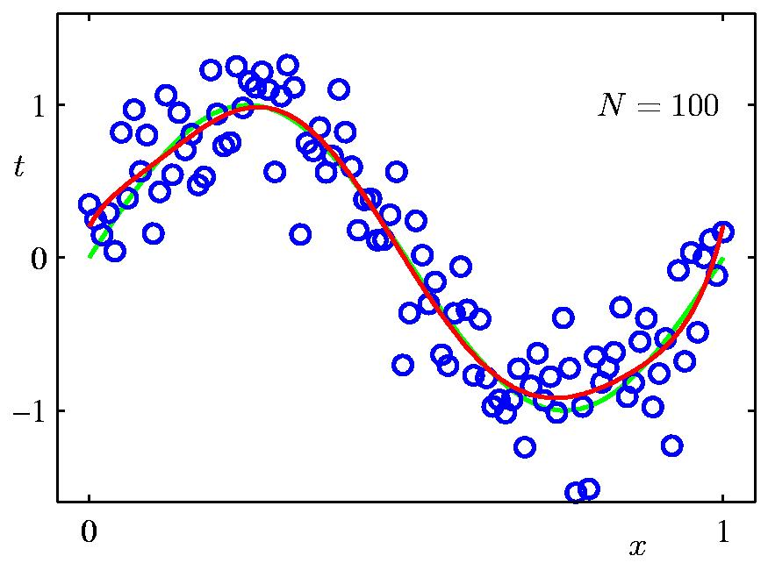
Dataset Size:
9th Order Polynomial fitted on 100 samples

Slide 20
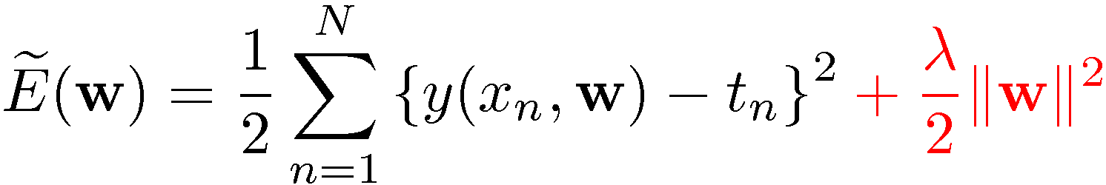
Regularization
Penalize large coefficient values

Slide 21

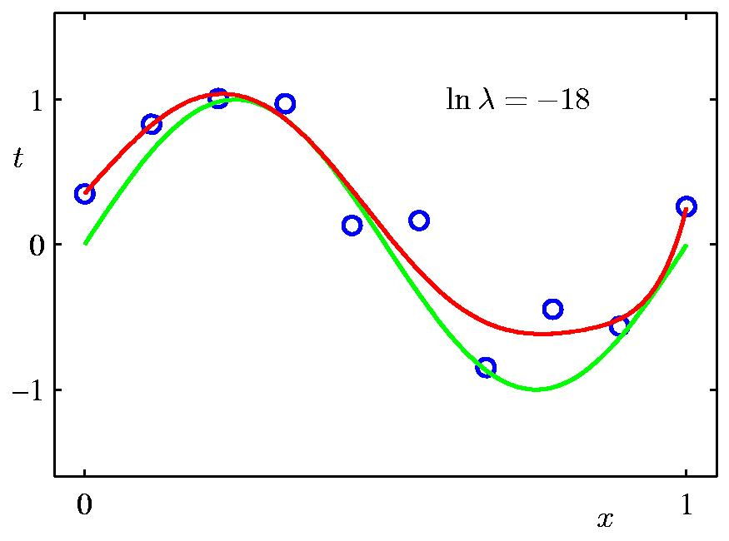
Regularization:

Slide 22

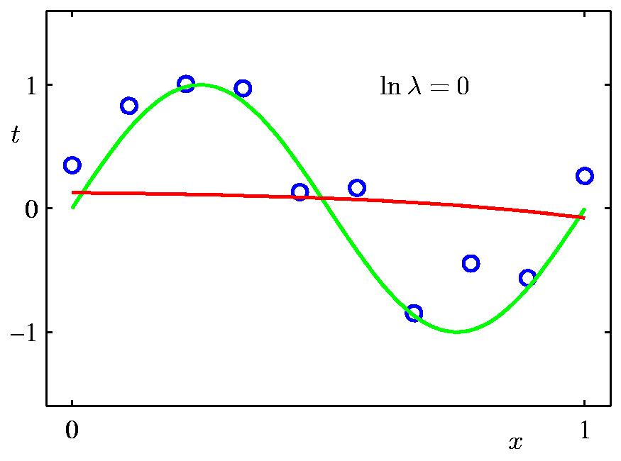
Regularization:

Slide 23


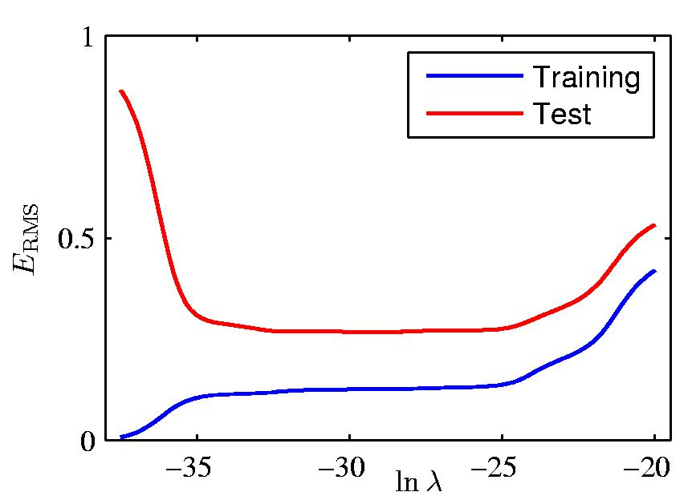
Regularization vs.

Slide 24
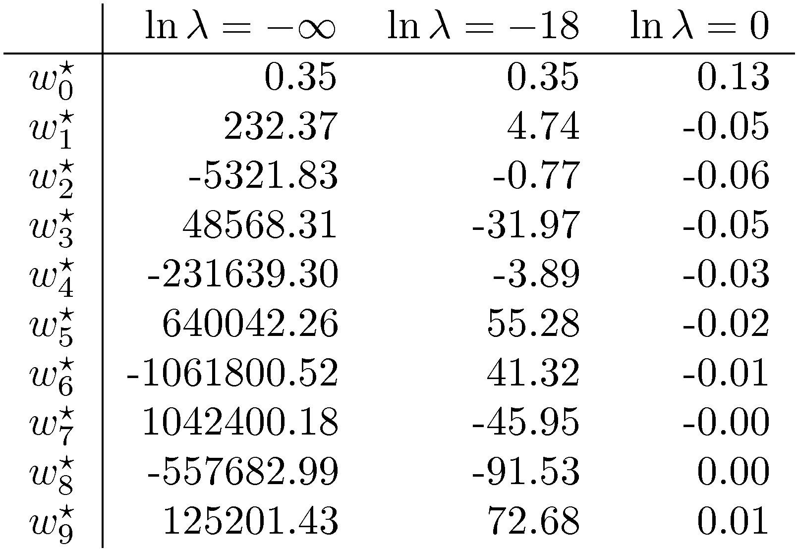
Polynomial Coefficients

